Slide 1
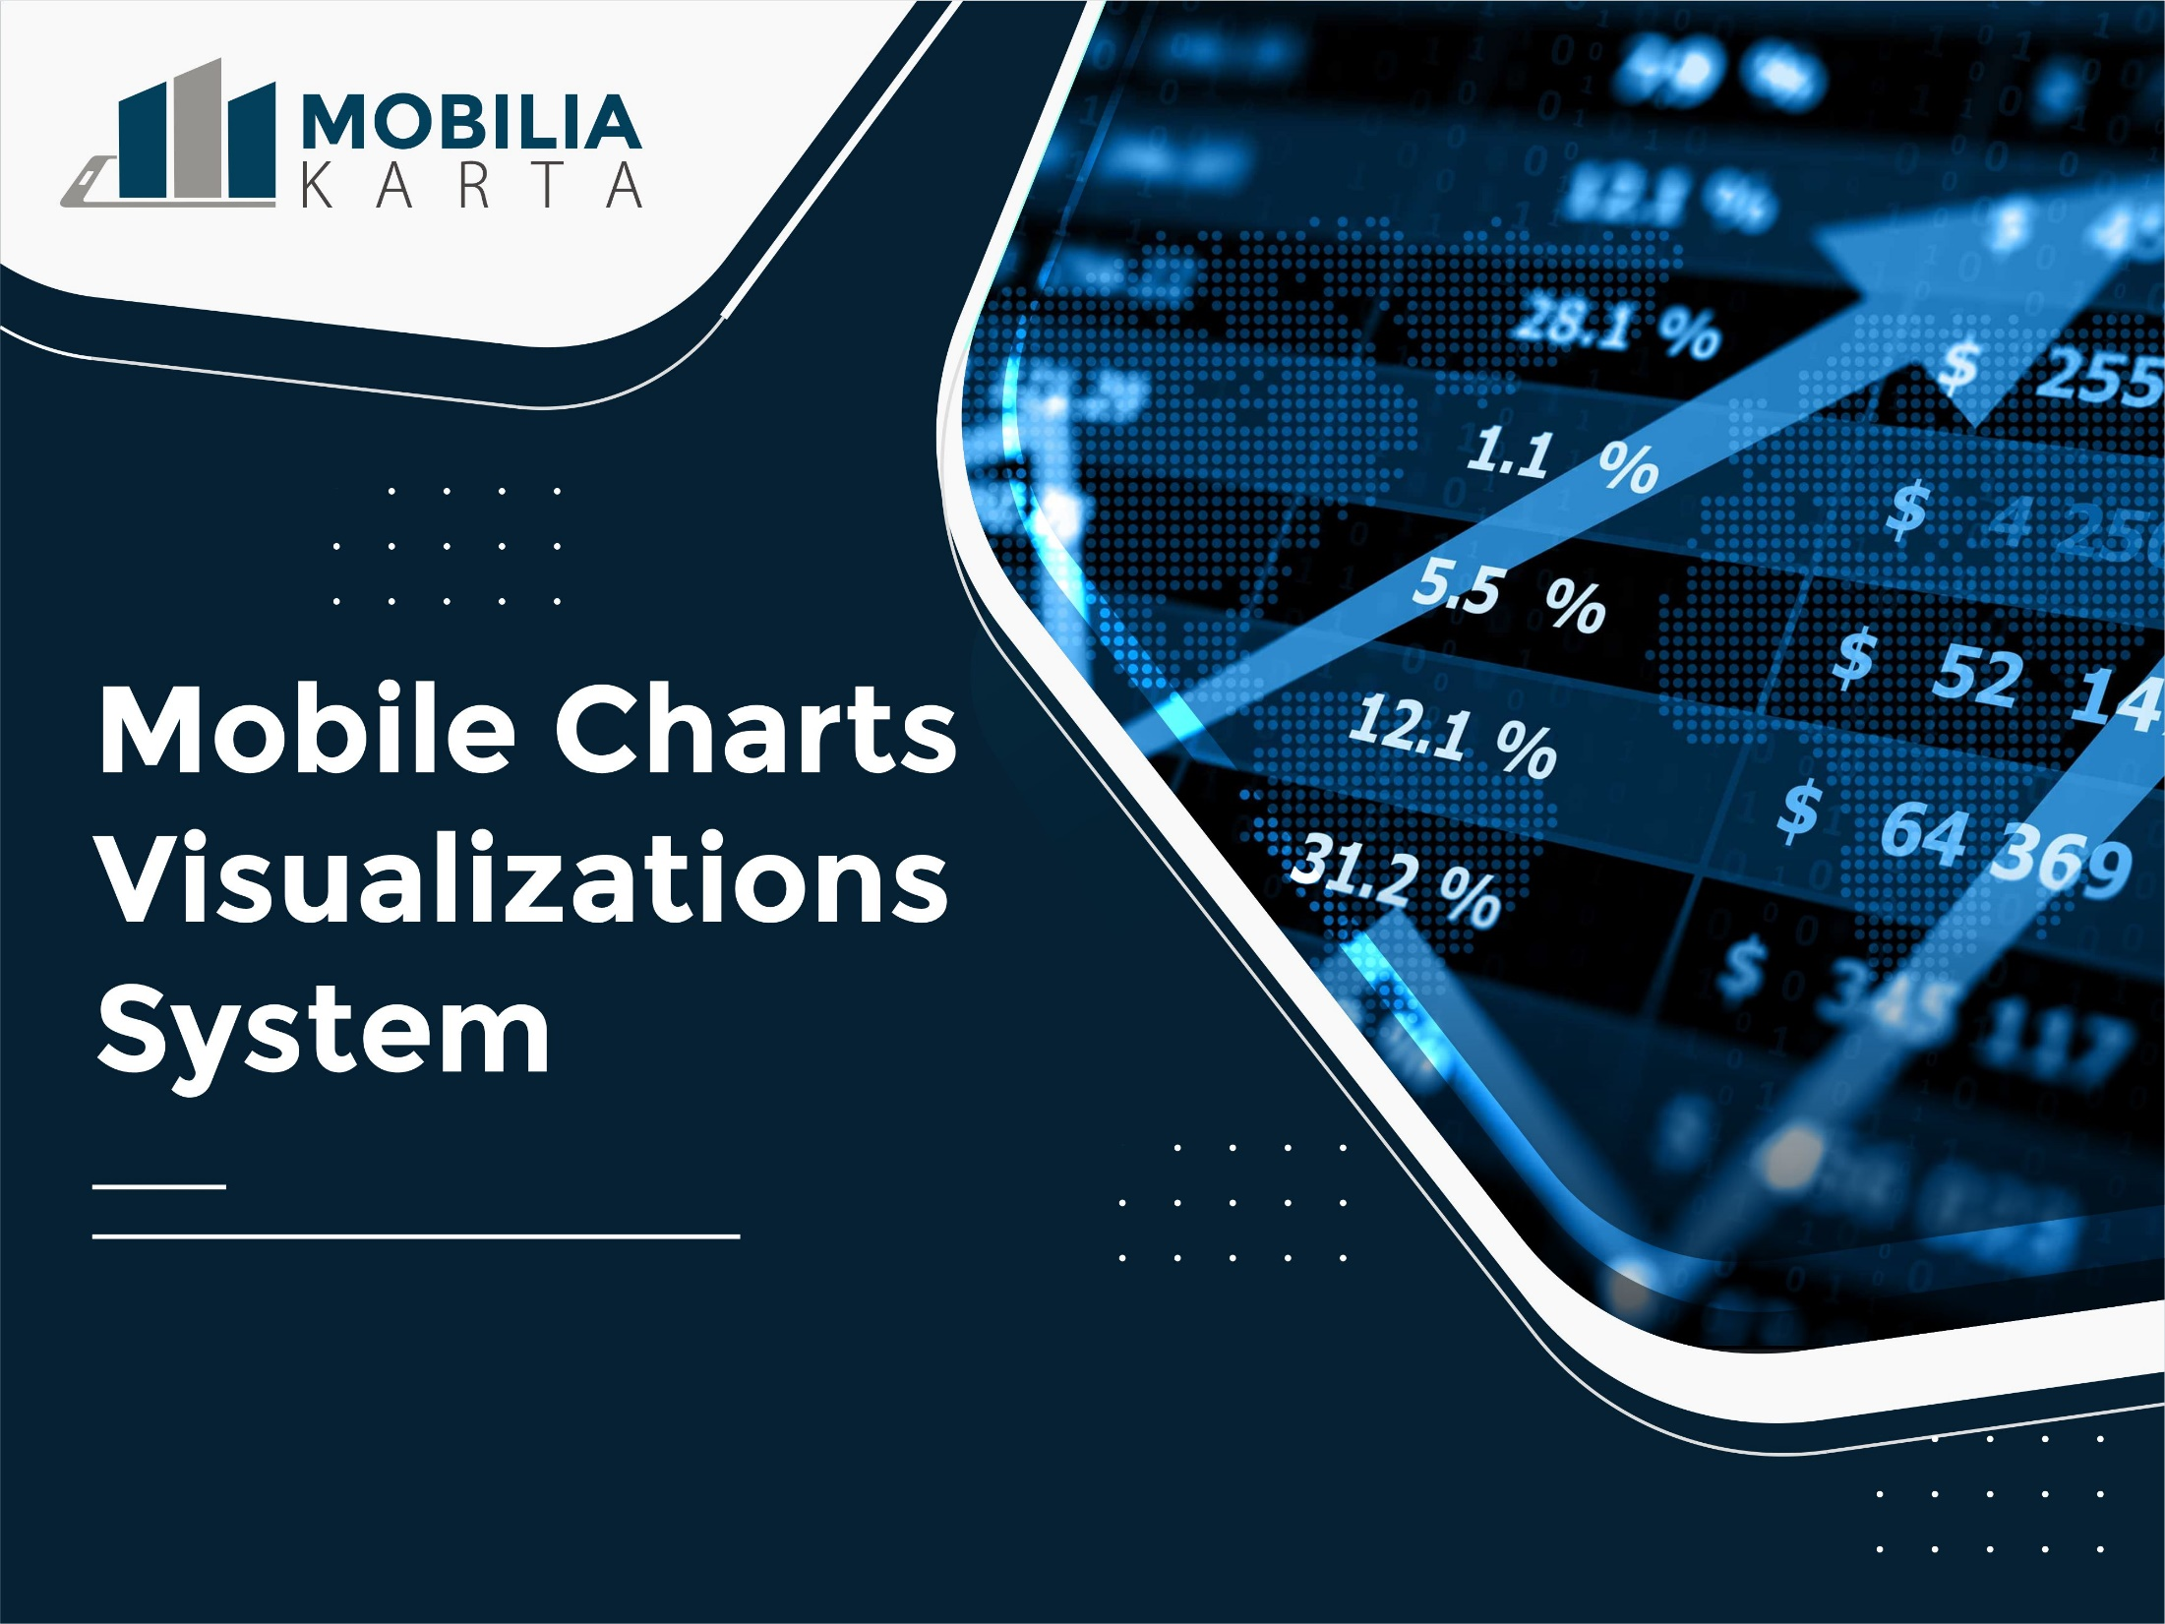

Slide 2

FEATURES
Business Intelligence
Explore data across the organisation and deliver insights at the point of decision with intuitive self-service analytics.
Augmented Analytics
Go the last mile of data-driven decision-making with machine-generated analytics and insights.

Slide 3
Planning
Link and create financial and operational plans seamlessly in one solution to drive better decisions with integrated plans.

Slide 4

Thank you

